Slide 1
Regerssion

Slide 2
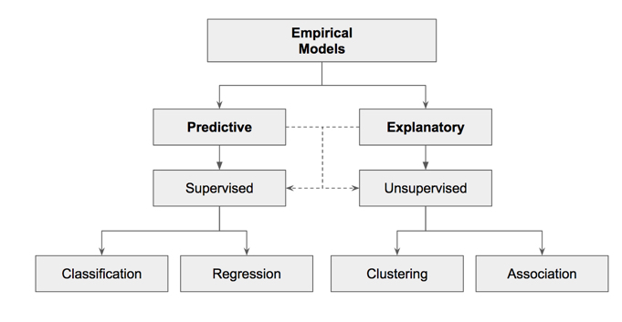

Slide 3
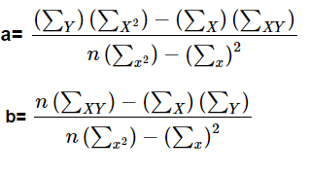
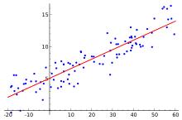
Linear regression
Y=a+bX

Slide 4
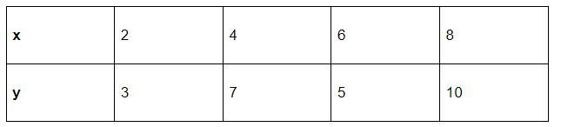
Solved Example

Slide 5
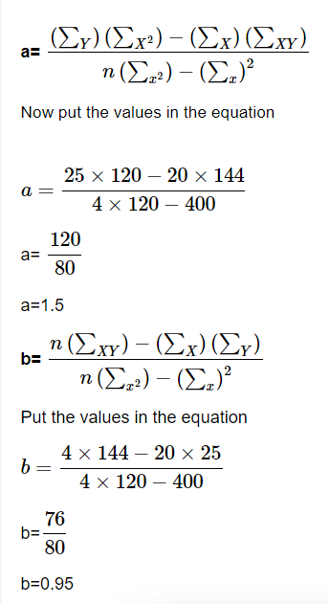
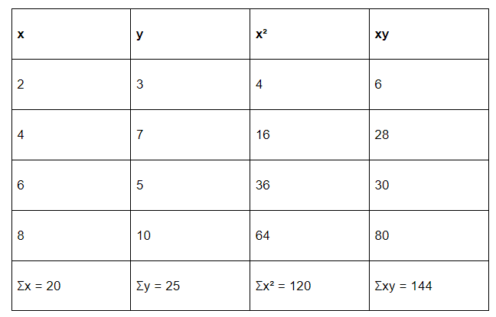
Eq.
y = 1.5 + 0.95x

Slide 6
Sales example

Slide 7
Month | Advertising | Sales
Jan | 40937 | 502729
Feb | 42376 | 507553
Mar | 43355 | 516885
Apr | 44126 | 528347
May | 45060 | 537298
Jun | 49546 | 544066
Jul | 56105 | 553664
Aug | 59322 | 563201
Sep | 59877 | 568657
Oct | 60481 | 569384
Nov | 62356 | 573764
Dec | 63246 | 582746

Slide 8
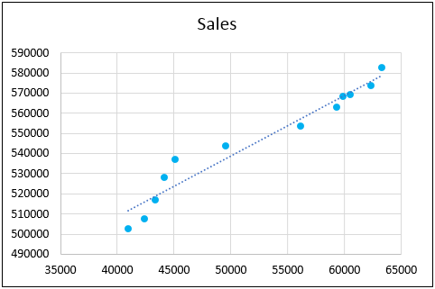

Slide 9
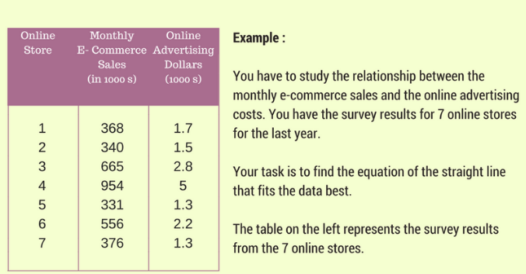

Slide 10
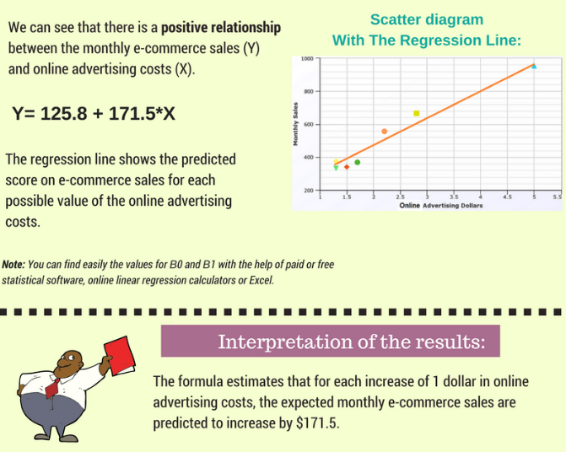

Slide 11
House prices example

Slide 12
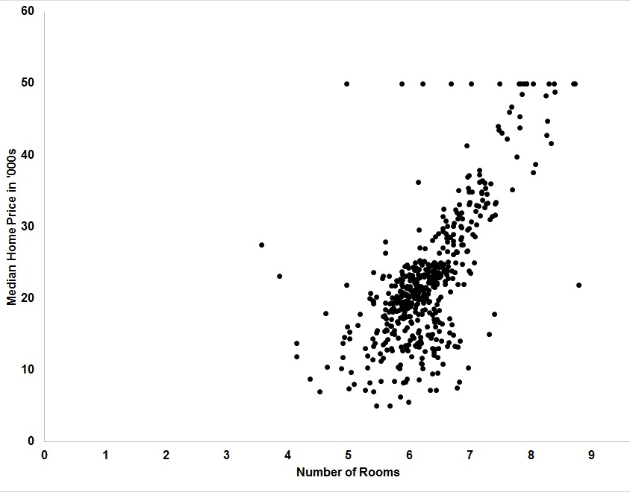
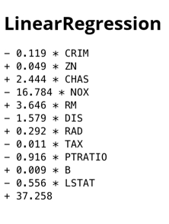

Slide 13


